Slide 1
Wel-Come to PIZZAHUT SQL PROJECT Presentation
We would like to offer you a stylish and reasonable presentation that will help you to promote your projects presentation

Slide 2
Basic
1) Retrieve the total number of orders placed.
2) Calculate the total revenue generated from pizza sales.
3) Identify the highest-priced pizza.
4) Identify the most common pizza size ordered.
5) List the top 5 most ordered pizza types along with their quantities.

Slide 3
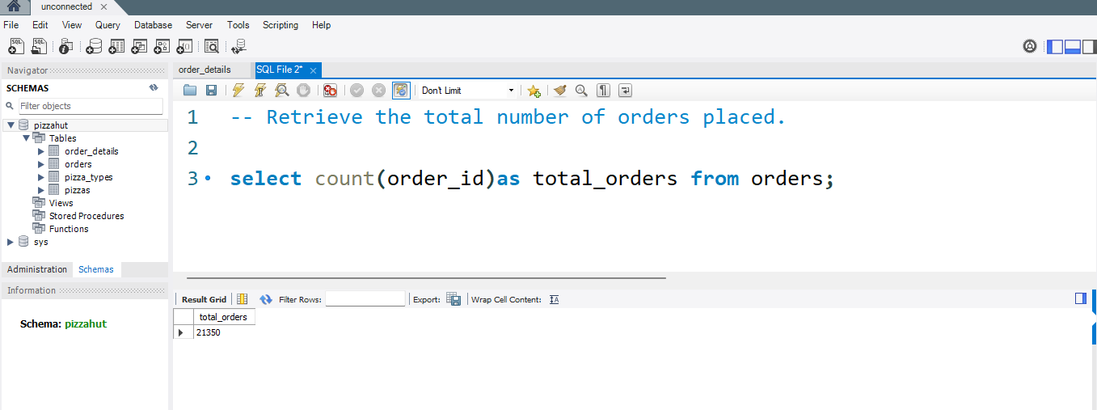
1) Retrieve the total number of orders placed.

Slide 4
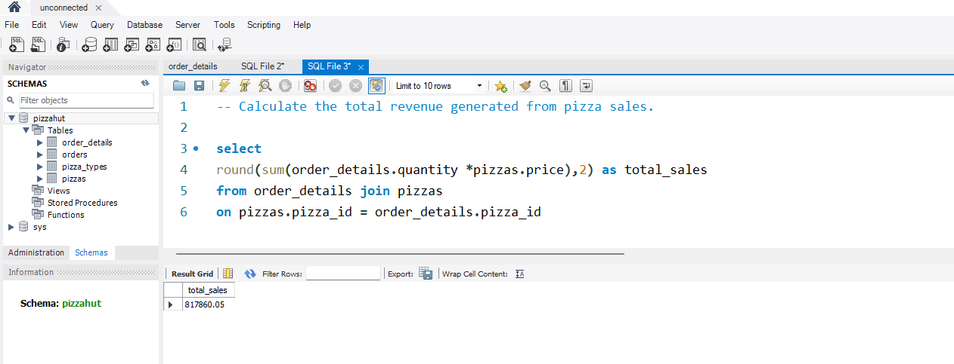
2) Calculate the total revenue generated from pizza sales.

Slide 5
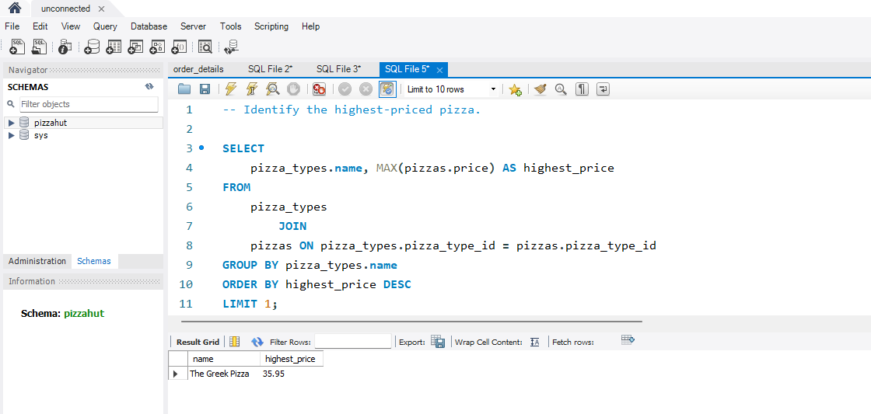
3) Identify the highest-priced pizza.

Slide 6
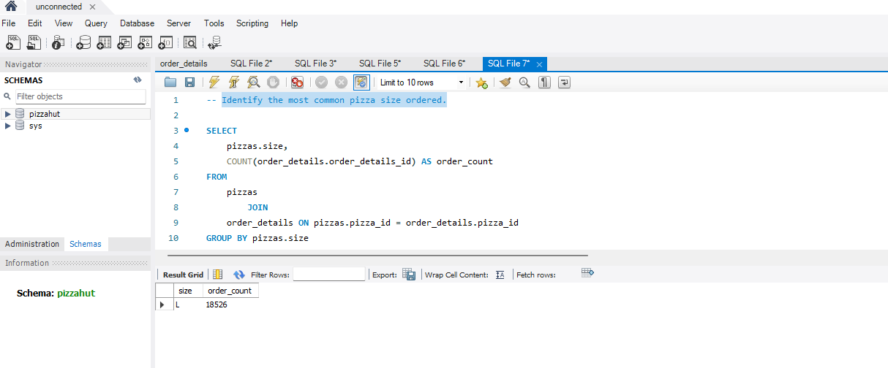
4) Identify the most common pizza size ordered.

Slide 7
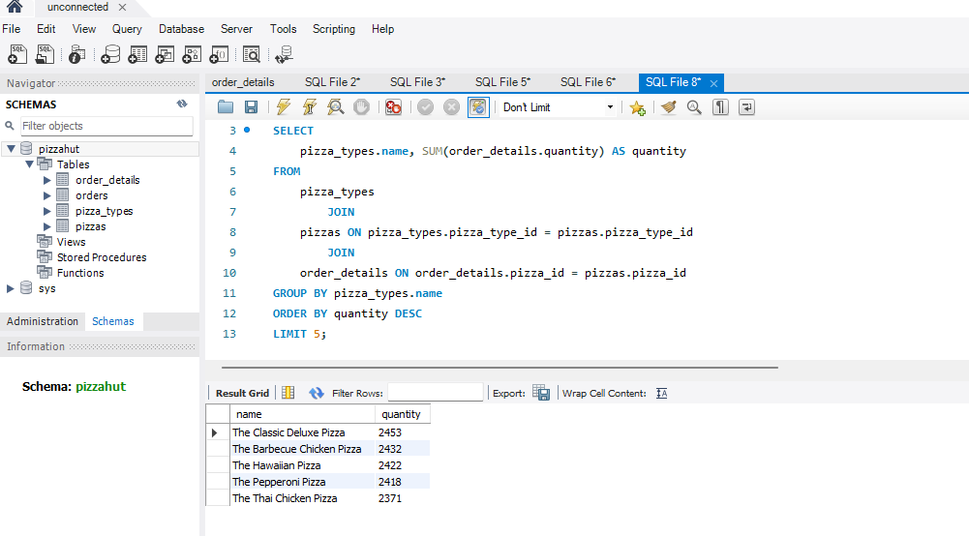
5) List the top 5 most ordered pizza types along with their quantities..

Slide 8
Intermediate
1) Join the necessary tables to find the total quantity of each pizza category ordered.
2) Determine the distribution of orders by hour of the day.
3) Join relevant tables to find the category-wise distribution of pizzas.
4) Group the orders by date and calculate the average number of pizzas ordered per day.
5) Determine the top 3 most ordered pizza types based on revenue.

Slide 9
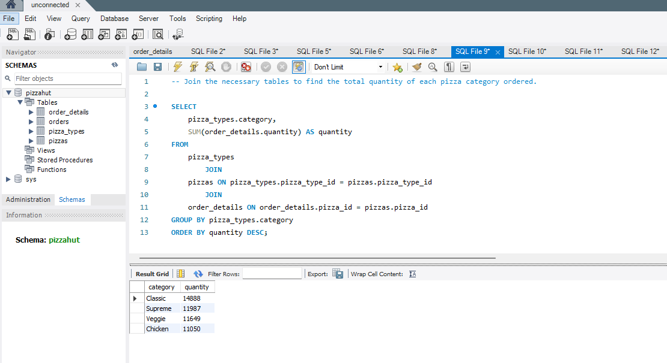
1) Join the necessary tables to find the total quantity of each pizza category ordered

Slide 10
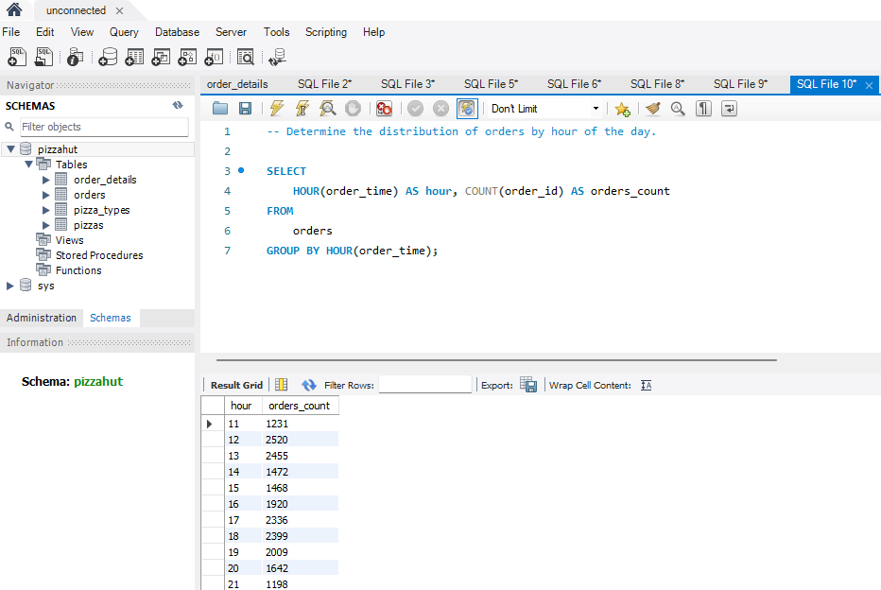
2) Determine the distribution of orders by hour of the day.

Slide 11
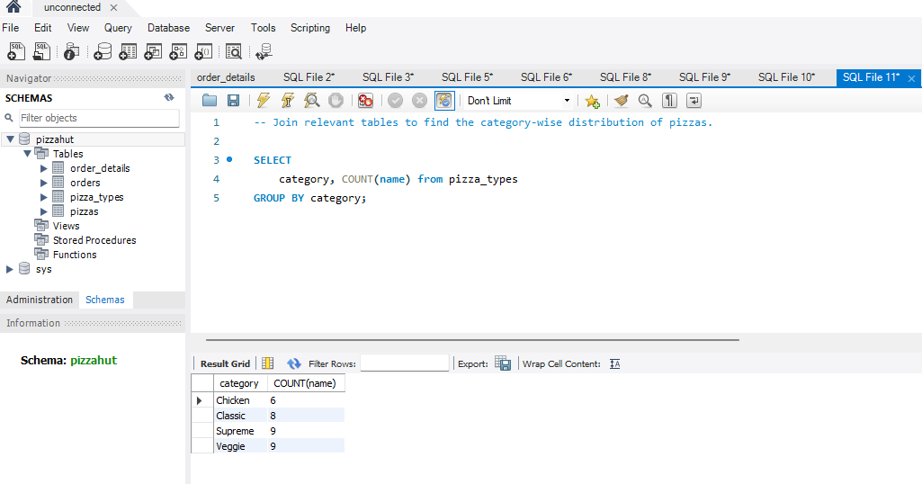
3) Join relevant tables to find the category-wise distribution of pizzas.

Slide 12
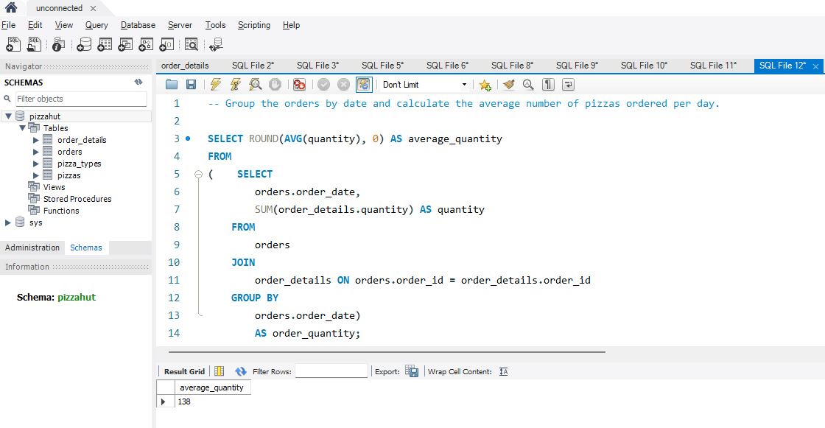
4) Group the orders by date and calculate the average number of pizzas ordered per day.

Slide 13
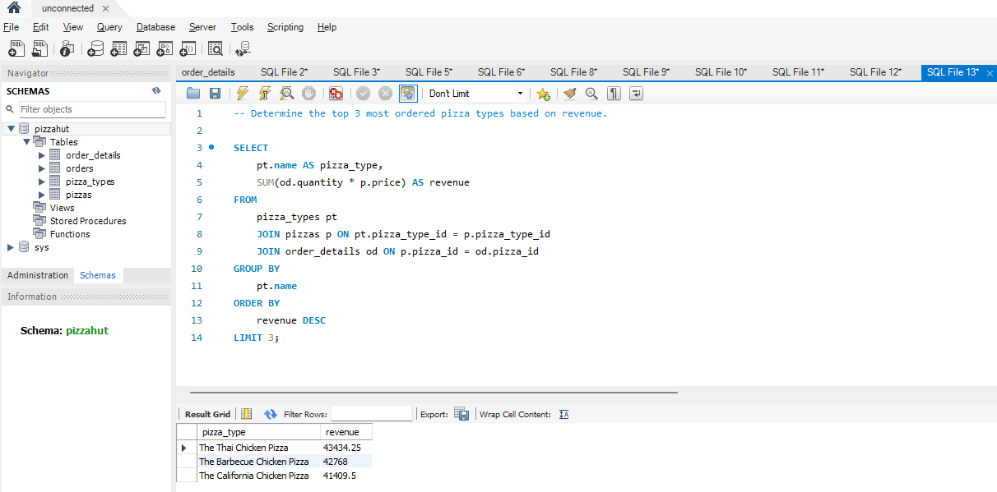
5) Determine the top 3 most ordered pizza types based on revenue.

Slide 14
Advanced
1) Calculate the percentage contribution of each pizza type to total
revenue.
2) Analyze the cumulative revenue generated over time.
3) Determine the top 3 most ordered pizza types based on revenue
for each pizza category.

Slide 15
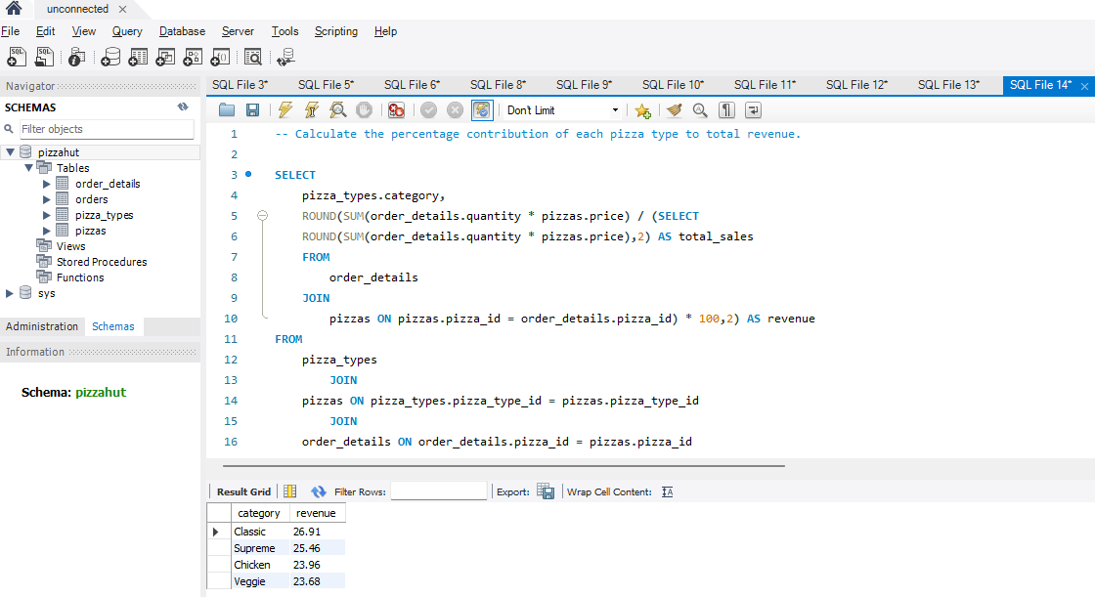
1) Calculate the percentage contribution of each pizza type to total revenue.

Slide 16
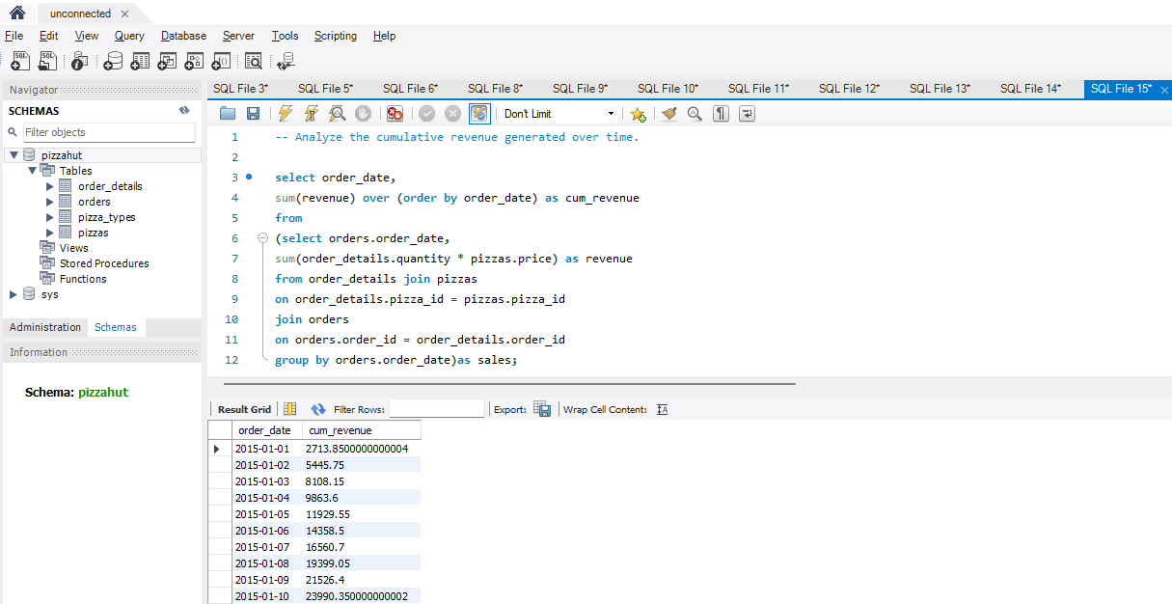
2) Analyze the cumulative revenue generated over time.

Slide 17
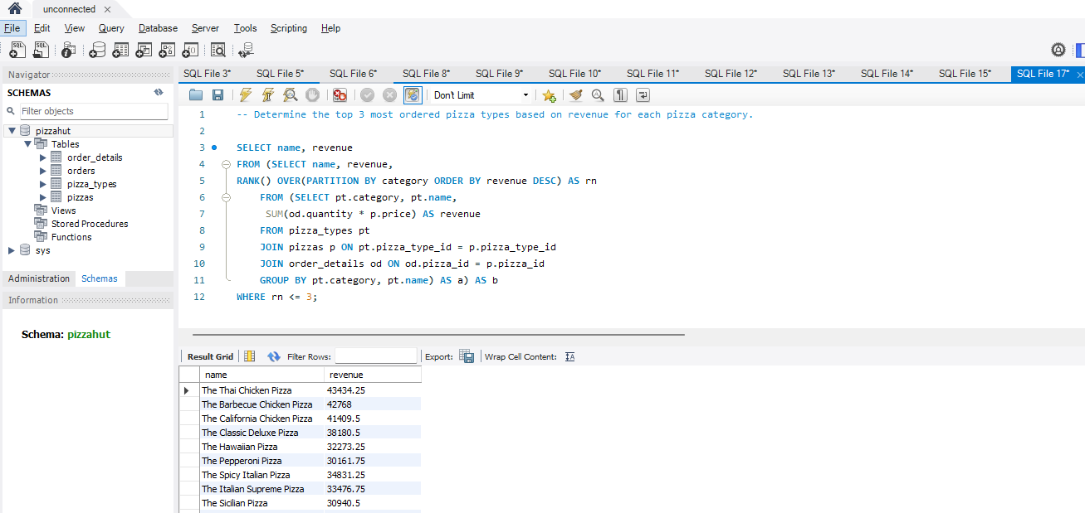
3) Determine the top 3 most ordered pizza types based on revenue for each pizza category.

Slide 18
THANK YOU

